Slide 1
Life Quality
&
Environmental Safety
Lisa Jo Gage, MSW
Tamerla Prince, BA

Slide 2
Federal Requirement 4: Independence
The setting/service optimizes but does not regiment individual initiative, autonomy and independence in making life choices, including daily activities, physical environment and with whom to interact.

Slide 3
Federal Requirement 10: Accessibility
The setting is physically accessible to the individual.

Slide 4
Life Quality
Characteristics of a person’s life that include those things that the person feels are most important, like good friend, good health, and a safe and comfortable place to live. To some, this is what makes life worth living.

Slide 5
Key Words
Inclusion
Friend
​Leisure
Individual Routines
​Natural Support

Slide 6
inclusion
Being a valued, full participant in the community, both giving to and benefitting from community life.
What does your agency do to promote inclusion?

Slide 7
Leisure
Free time for relaxation, fun and recreation.
What does your agency do to promote leisure activities?

Slide 8
Entertainment Locations and Attractions | Parks, playground, beach, museums, saw the big duck at the point, zoo, casinos, Dave and Buster’s
Relationship-Oriented | birthday parties, volunteer, being with friends, go to friend’s house, go on home visits, going out with aide and friends, being with boyfriend, movies with friends, parties, social events, socialize
Church | any response related to church
Unspecified Outdoor Activities | go/play/run outdoors, picking flowers, roaming around family farm, working outdoors
Food and Drink Oriented | bakes, bakes cookies, cooking, dinners (eating), Dunkin Donuts, have a drink, snack time

Slide 9
Arts/Crafts/Creativity | arts and crafts, beading, coloring, crochet, does pottery plants, drawing, knits hats and scarves, makes bracelet bands and key chains, making jelly bracelets, painting
Sensory Activities | likes tactile simulation, sensory activities, stimulation, taking a bath
Music | listening to music such as country music, gospel music, heavy metal music, rides in the car with music, singing, karaoke, dancing
Animal-Oriented | likes her pets, play with animals, play with the cat, rides horses, walking dogs
Miscellaneous | attention, items of interest, getting dirty, role play, holiday stuff, playing with toys, travel

Slide 10
Friend
A person who you like to be with and who likes to be with you. A person with whom you have fun. Someone who supports you and offers a sympathetic ear when you have problems that you want to talk about.
How does your agency promote friendships?

Slide 11
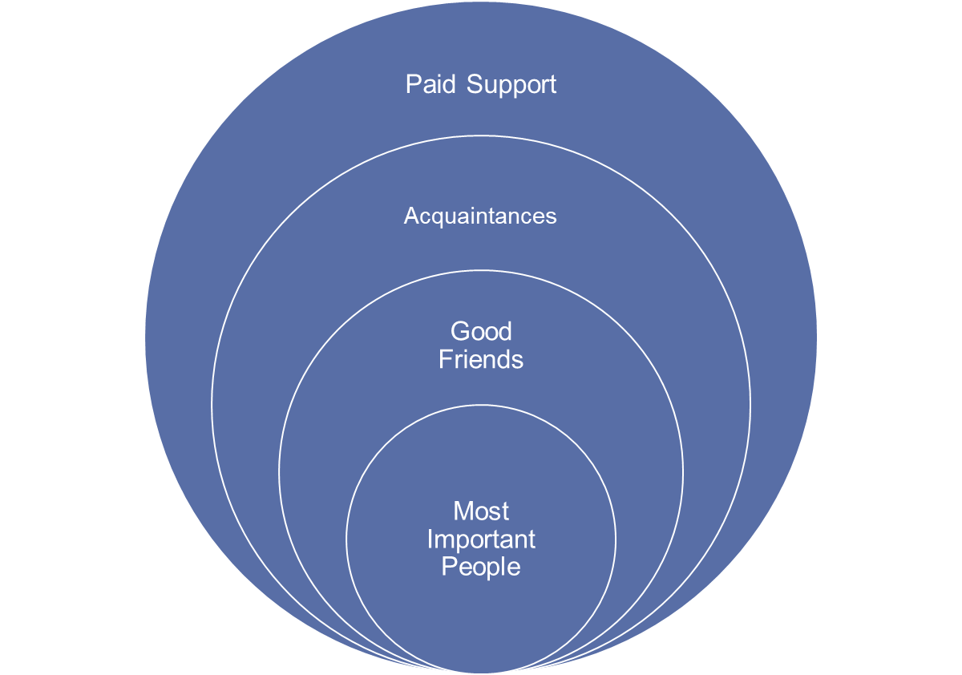
Kinds of friendships

Slide 12
Types of friendships
Most Important to Us: Most of us have at least one. Same for the individuals we support.
Good Friends: Most of us list 5 or more. Individuals we support often list no one or only paid staff.
Acquaintances: Most of us list 5-10. Individuals we support may name no one.
Paid Support: Most of us list 5-10. Individuals we support may list more than 10.

Slide 13
Natural support
Natural supports are personal associations and relationships typically developed in the community that enhance the quality and security of life for people, including, but not limited to, family relationships; friendships reflecting the diversity of the neighborhood and the community; association with peers.

Slide 14
How to build natural supports
Stand alongside the person with disabilities and alongside community members as well. Be a “regular” person rather than the professional. Establish circles of support around a specific person. Involve community members and let them know how they can help.
What does your agency due to promote natural supports?

Slide 15
Individual routines
Things that people do every day, every week, every month, or every year. Comfort Routines.
What does your agency do to support individual’s daily, weekly, month or yearly routines?

Slide 16





Things to consider
Daily
weekly
Monthly
Yearly
Comfort
Does everyone you know use the same flavor toothpaste? Shower before or after breakfast?
What church? Favorite TV show. Laundry day.
Choice of fun activity. Dinner with friends.
Holidays
Go home and lay down. Eat chocolate. Talk to someone.

Slide 17
The quality, not the longevity, of one’s life is what is most important.
Dr. Martin Luther King Jr.

Slide 18
Environmental safety
Safety means doing things in a correct and careful manner in order to have an environment that is free of danger and hazard.

Slide 19





SAFETY AROUND THE HOUSE
aCCIDENTS
CAUSES
FALLS
FIRE
pOISON
20,000 persons dies every year from home accidents
Three major sources are falls, fires, and poisonings.
Falls were the 3rd leading cause of injury-related deaths of all ages.
85% of all fire deaths occur in the home.
82 people dies everyday in unintentional poisonings.

Slide 20
Create a safe environment
Have good lighting
Free of clutter AND SPACE TO MOVE FREELY
Practice emergency response plans
LOOK FOR POSSIBLE HAZARDS
WHEELCHAIR SAFETY
PREVENTION
IS THE
NUMBER
ONE
PRIORITY!

Slide 21
Preventing Poisonings
Poisonous products include household cleaning products, medications, insecticides, cosmetics
Products must be stored in their original container.
Kept separate from food products.
Kept out of easy reach and locked up.

Slide 22
Accidental Poisoning
Call the Poison Control Center first.
1-800-222-1222
Not 911 first!

Slide 23
Preventing Falls
Have fall precautions in IPP.
Assure mobility aids are in good working order.
Provide handrails and guard rails.
Keep floors dry.
Be sure there is no clutter on the floor.

Slide 24
Causes of Falls
Individuals we support may be at risk due to the disability such as CP, health problems such as epilepsy, and sedating medication.

Slide 25
Preventing Fires
In home sprinkler systems best. Hardwired systems.
Test smoke detector monthly and replace batteries 2 time per year.
Fire extinguishers and training on how to use them.
Required to have fire drills regularly.
Required to have fire escape plan.
Do not overload electrical wiring.

Slide 26
Community of practice
What resources do you use to train your DSPs in household safety including prevention and responses?

Slide 27
Disaster Plans
Must have a completed Disaster Plan for Residential Care Facilities posted.

Slide 28
Wheelchair Safety
Is it in good working order and have the necessary adaptations?
Be aware of the environment and look for changing surface levels, inclines, ramps, and adequate room to move in.
Getting over curbs: Up curb-raise front casters then roll large wheels over. Down curb-turn around and take large wheel down first.

Slide 29
Community of practice
How do you conduct wheelchair safety training for your DSPs? What resources do you use?

Slide 30
Environmental emergency
have the right things available
decide who will do what
hold disaster drills
complete the right actions in an emergency
Prepare
Plan
Practice
Perform

Slide 31
Responding to Environmental Disaster
Prepare: first aid kit and book, battery powered radio and flashlights, bottled water and 1 week food supply, tool to turn off gas and water, individualized items for each person.
Plan: Have current Disaster Plan and assure DSPs are aware of the plan.
Practice: drills, training how to turn of gas, water, and electricity, CPR/first aid certified.
Perform: When disaster occurs, stay calm and follow the training.

Slide 32
Community of practice
Do you practice environmental emergencies in addition to fire drills? What emergencies have you practiced and how did you do it?

Slide 33
Life quality & environmental safety
What does environmental safety have to do with quality of life?

Slide 34
Additional resources
Feeling safe, Being safe workbook and training videos
https://www.dds.ca.gov/consumers/emergency-preparedness-consumer/
Positive Environment Checklist
https://drive.google.com/drive/folders/1rEgcElGkfoSGiLYMYHF34gwDSPyhwz1w
Click on number 14 (Session 11). Go to page S21-23

Slide 35
Next residential training date
August 16th @ 10am
Successful Teaching including Positive Behavior Supports

